Slide 1
The Simple Regression Model II
Prof. Sebastián Vallejo Vera

Slide 2
Two other elements from OLS estimates need to be addressed before moving on:
Units of measurement
Functional form

Slide 3
Units of Measurement
The OLS estimates change in entirely expected ways when the units of measurement of the dependent and independent variables change because changing the units of measurement does not change the relationship between the dependent and independent variable.
For example, the relationship between education (in years of schooling) and annual income (calculated in dollars) is unchanged if annual income is measured instead in thousands of dollars.
The goodness-of-fit and related measures like the R2 are also unaffected when the units of measurement of the dependent and independent variables are changed.

Slide 4
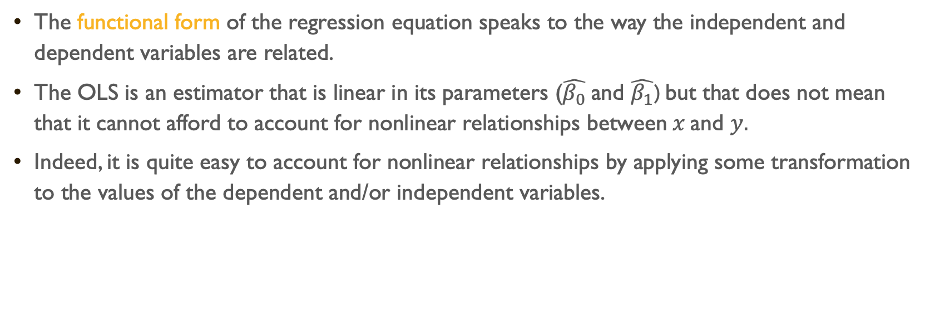
Functional Form
The functional form of the regression equation speaks to the way the independent and dependent variables are related.
The OLS is an estimator that is linear in its parameters ($\hat{β_{0}}$and $\hat{β_{1}}$) but that does not mean that it cannot afford to account for nonlinear relationships between$x$and $y.$
Indeed, it is quite easy to account for nonlinear relationships by applying some transformation to the values of the dependent and/or independent variables.

Slide 5
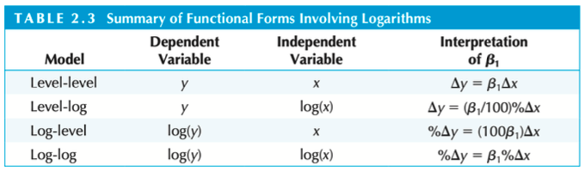
It is common to apply the natural logarithm to either the dependent variable or to both the dependent and independent variables (see below) or take the square of the independent variable (see next slide) to allow for some nonlinearities in a regression model (more on that later).

Slide 6
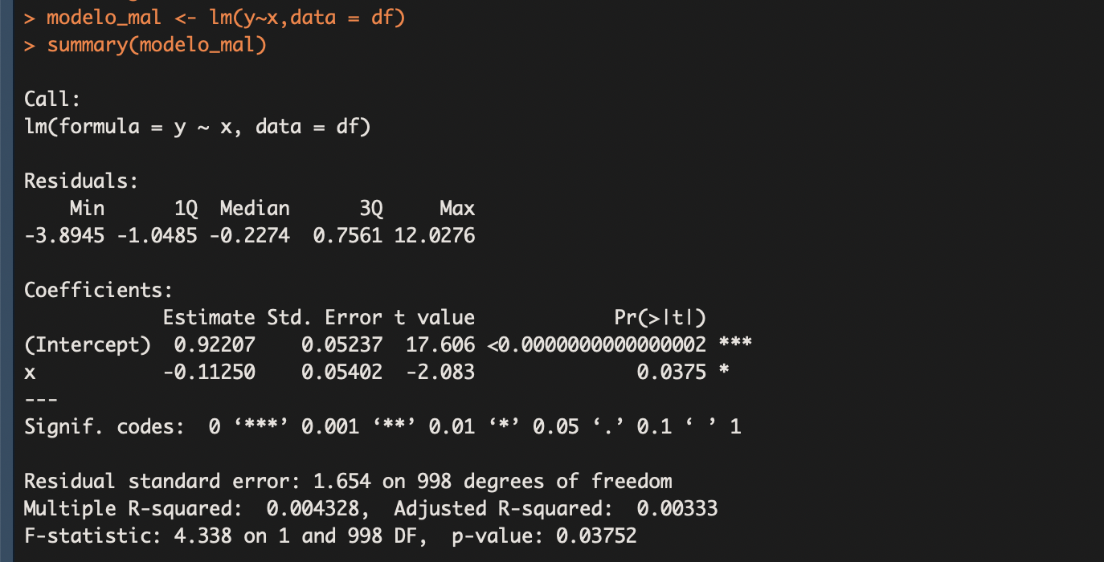

Slide 8
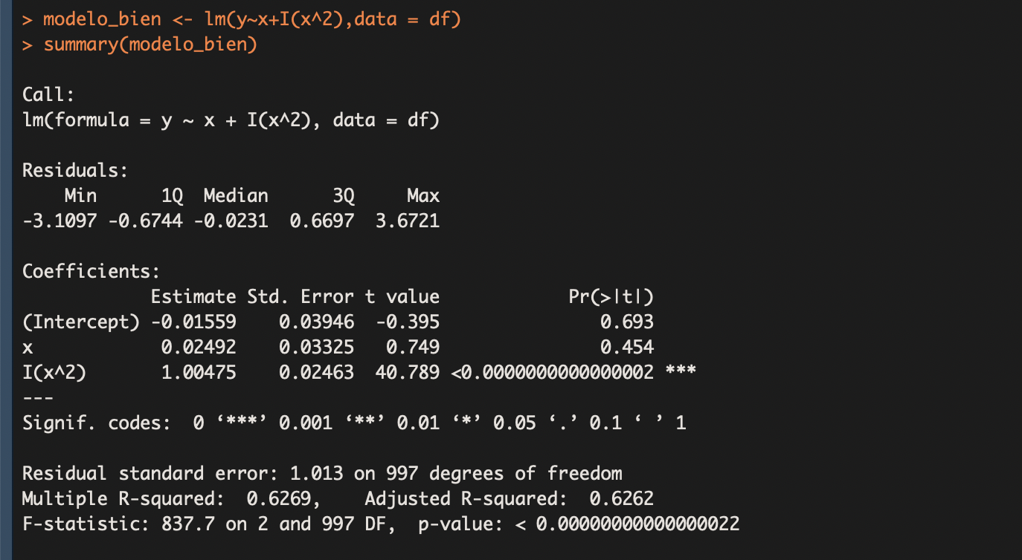

Slide 10
Expected Values and Variance of the OLS Estimators

Slide 11
Last week we ended on the following note:

Slide 12
The SRM and causality
Now, does the SRM allow us to draw ceteris paribus conclusions about how X affects Y?
The answer depends on how the unobserved U term relates to the explanatory variable X.
But the short answer for the SRM is not likely at all. Most phenomena are explained by more than one factor, many of which are correlated with the explanatory variable X . (More on this later)

Slide 13

So, apparently, that unobserved U term seems to be of particular interest/concern when obtaining OLS estimates.
In this section, we study the properties of the distributions of $\hat{β_{0}}$and $\hat{β_{1}}$over different random samples from the population.

Slide 14
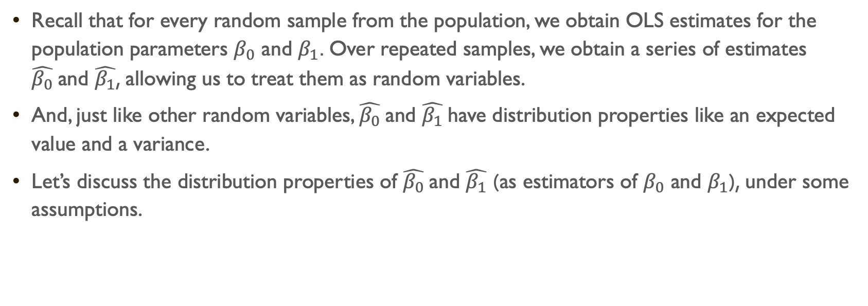
Recall that for every random sample from the population, we obtain OLS estimates for the population parameters $β_{0}$ and $β_{1}$. Over repeated samples, we obtain a series of estimates $\hat{β_{0}}$and $\hat{β_{1}}$, allowing us to treat them as random variables.
And, just like other random variables, $\hat{β_{0}}$and $\hat{β_{1}}$have distribution properties like an expected value and a variance.
Let’s discuss the distribution properties of $\hat{β_{0}}$and $\hat{β_{1}}$ (as estimators of $β_{0}$ and $β_{1}$), under some assumptions.

Slide 15
The Assumptions
From now on, we’ll use “SLR” to refer to Simple Linear Regression.

Slide 16
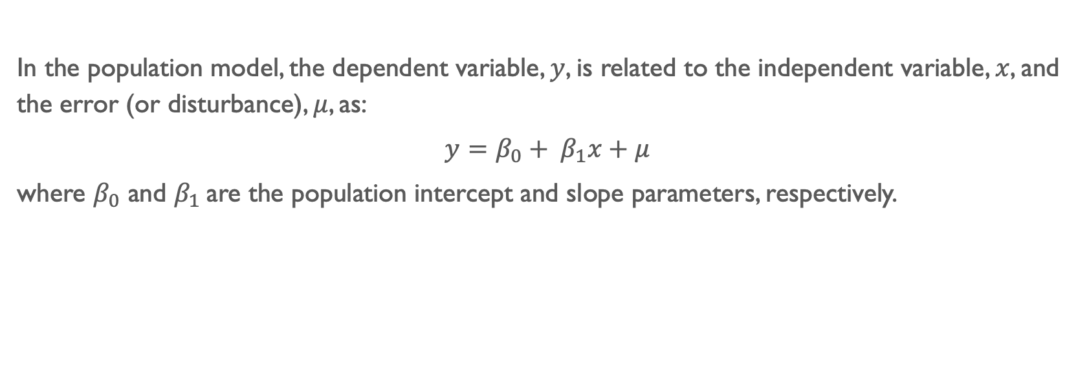
Assumption SLR.1: Linear in parameters
In the population model, the dependent variable, $y$, is related to the independent variable, $x$, and the error (or disturbance), $μ$, as:
$y=β_{0}+ β_{1}x+μ$
where $β_{0}$ and $β_{1}$are the population intercept and slope parameters, respectively.

Slide 17

Assumption SLR.2: Random sampling
We have a random sample of size $n$, $\{\left(x_{i} , y_{i}\right):i=1, …, n\}$, following the population model:
$y=β_{0}+ β_{1}x+μ$

Slide 18

Assumption SLR.3: Sample variation in the explanatory variable
The sample outcomes on $x$, namely, $\{x_{i}:i=1, …, n\}$, are not all the same value. In other words, the independent variable is not a constant.

Slide 19
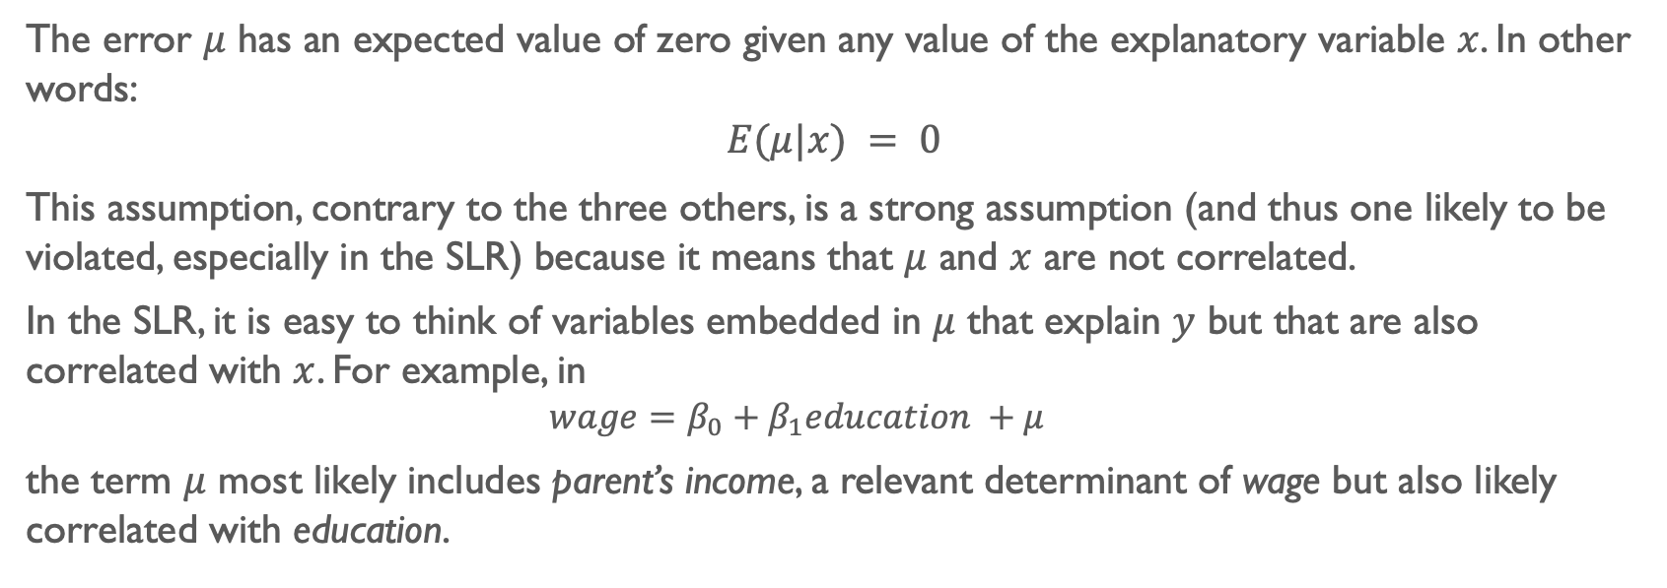
Assumption SLR.4: Zero conditional mean
The error $μ$ has an expected value of zero given any value of the explanatory variable $x$. In other words:
$$E(μ|x) = 0$$
This assumption, contrary to the three others, is a strong assumption (and thus one likely to be violated, especially in the SLR) because it means that $μ$ and $x$ are not correlated.
In the SLR, it is easy to think of variables embedded in $μ$ that explain $y$ but that are also correlated with $x$. For example, in
$$wage=β_{0}+β_{1}education +μ$$
the term $μ$ most likely includes parent’s income, a relevant determinant of wage but also likely correlated with education.

Slide 20
Theorems
From the Assumptions…

Slide 21
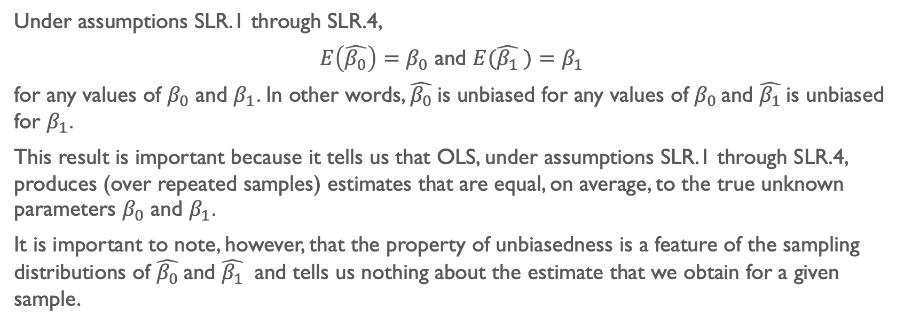
Theorem SLR.1: Unbiasedness of OLS
Under assumptions SLR.1 through SLR.4,
$E\left(\hat{β_{0}}\right)=β_{0}$ and $E(\hat{β_{1}} )=β_{1}$
for any values of $β_{0}$ and $β_{1}$. In other words, $\hat{β_{0}}$is unbiased for any values of $β_{0}$ and $\hat{β_{1}}$is unbiased for $β_{1}$.
This result is important because it tells us that OLS, under assumptions SLR.1 through SLR.4, produces (over repeated samples) estimates that are equal, on average, to the true unknown parameters $β_{0}$ and $β_{1}$.
It is important to note, however, that the property of unbiasedness is a feature of the sampling distributions of $\hat{β_{0}}$and $\hat{β_{1}}$ and tells us nothing about the estimate that we obtain for a given sample.

Slide 22
Let’s see this in action (go to code for 6 Simple Regression Model II.R / Vignette 5.1)

Slide 23
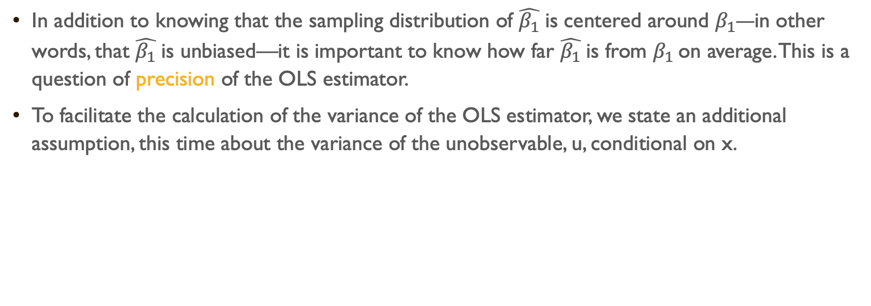
In addition to knowing that the sampling distribution of $\hat{β_{1}}$is centered around $β_{1}$—in other words, that $\hat{β_{1}}$is unbiased—it is important to know how far $\hat{β_{1}}$is from $β_{1}$ on average. This is a question of precision of the OLS estimator.
To facilitate the calculation of the variance of the OLS estimator, we state an additional assumption, this time about the variance of the unobservable, u, conditional on x.

Slide 24
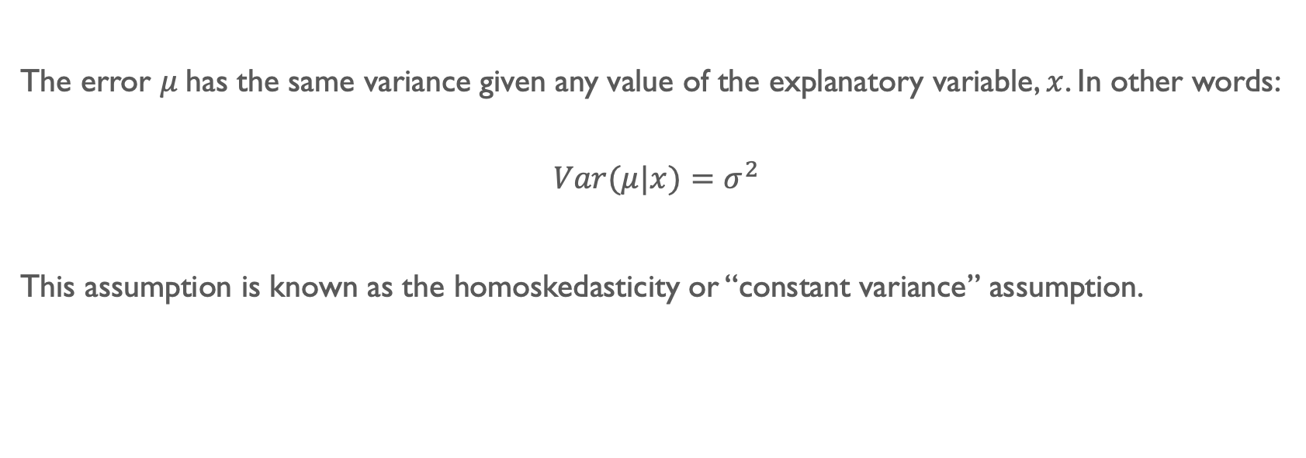
Assumption SLR.5: Homoskedasticity
The error $μ$has the same variance given any value of the explanatory variable, $x$. In other words:
$$Var(μ|x)=σ^{2}$$
This assumption is known as the homoskedasticity or “constant variance” assumption.

Slide 25

$σ^{2}$ is referred to as the error variance and its square root, $σ$, is the standard deviation of the error, $μ$. A larger $σ$ therefore means that the distribution of the unobservables affecting $y$ is more spread out.

Slide 26
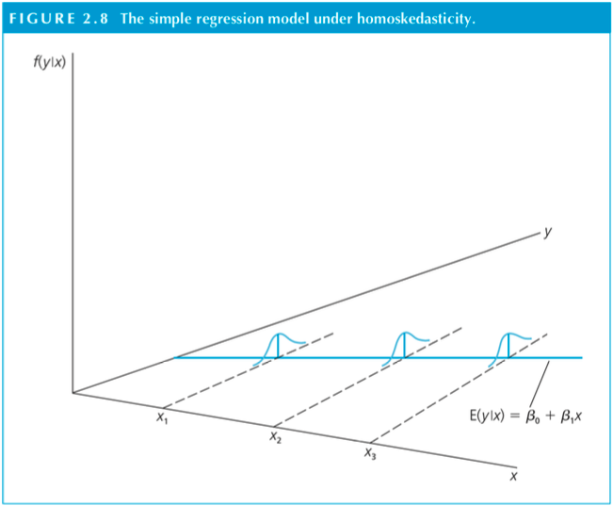

Slide 27

$σ^{2}$ is referred to as the error variance and its square root, $σ$, is the standard deviation of the error, $μ$. A larger $σ$ therefore means that the distribution of the unobservables affecting $y$ is more spread out.
Now, when $Var(μ|x)$depends on $x$, the error term is said to exhibit heteroskedasticity (or nonconstant variance).

Slide 28
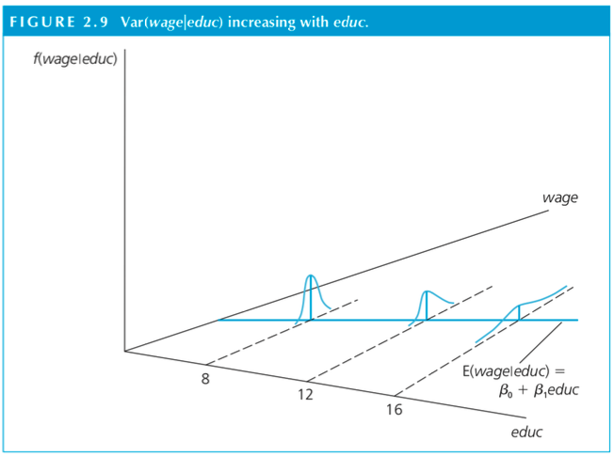

Slide 29
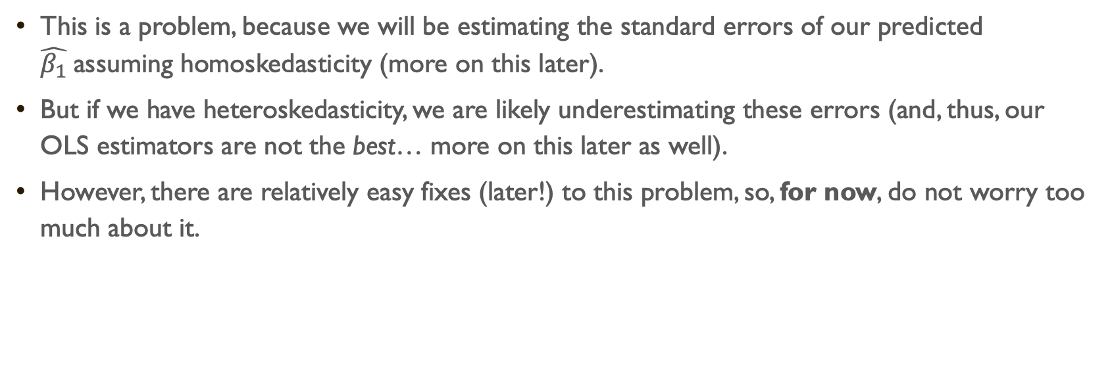
This is a problem, because we will be estimating the standard errors of our predicted $\hat{β_{1}}$assuming homoskedasticity (more on this later).
But if we have heteroskedasticity, we are likely underestimating these errors (and, thus, our OLS estimators are not the best… more on this later as well).
However, there are relatively easy fixes (later!) to this problem, so, for now, do not worry too much about it.

Slide 30
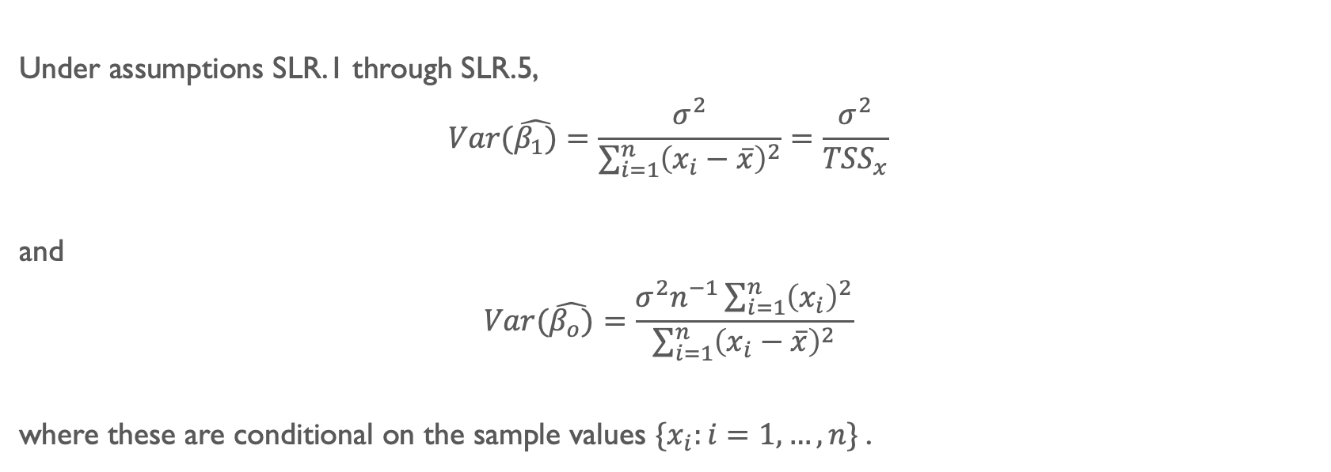
Theorem SLR.2: Sampling variances of the OLS estimators
Under assumptions SLR.1 through SLR.5,
$$Var(\hat{β_{1})}=\frac{σ^{2}}{\sum_{i=1}^{n}{{\left(x_{i}−\overline{x}\right)}^{2}}}=\frac{σ^{2}}{{TSS}_{x}}$$
and
$$Var(\hat{β_{o})}=\frac{σ^{2}n^{−1}\sum_{i=1}^{n}{{\left(x_{i}\right)}^{2}}}{\sum_{i=1}^{n}{{\left(x_{i}−\overline{x}\right)}^{2}}}$$
where these are conditional on the sample values $\{x_{i}:i=1, …, n\}$.

Slide 31
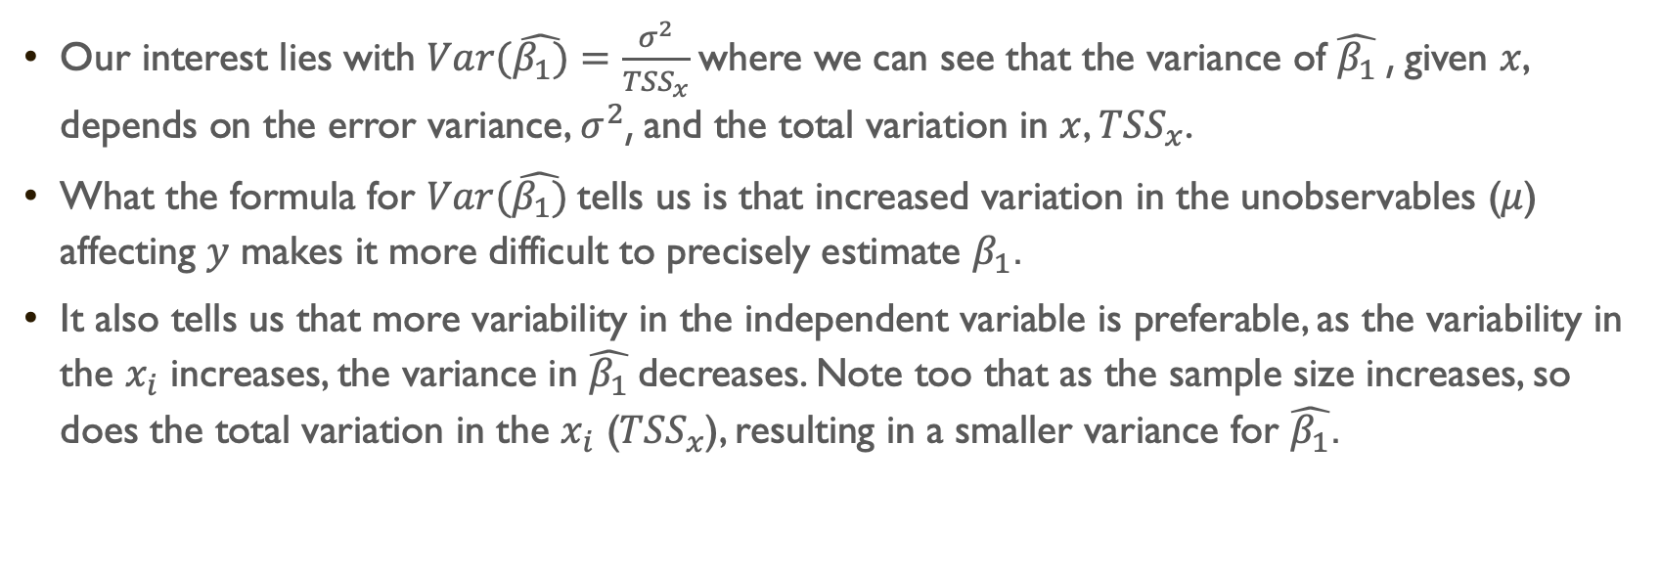
Our interest lies with $Var(\hat{β_{1})}=\frac{σ^{2}}{{TSS}_{x}}$where we can see that the variance of $\hat{β_{1}}$, given $x$, depends on the error variance, $σ^{2}$, and the total variation in $x$, ${TSS}_{x}$.
What the formula for $Var(\hat{β_{1})}$tells us is that increased variation in the unobservables ($μ$) affecting $y$ makes it more difficult to precisely estimate $β_{1}$.
It also tells us that more variability in the independent variable is preferable, as the variability in the $x_{i}$ increases, the variance in $\hat{β_{1}}$decreases. Note too that as the sample size increases, so does the total variation in the $x_{i}$ (${TSS}_{x}$), resulting in a smaller variance for $\hat{β_{1}}$.

Slide 32
Let’s see this in action (go to code for 6 Simple Regression Model II.R / Vignette 5.2)

Slide 33
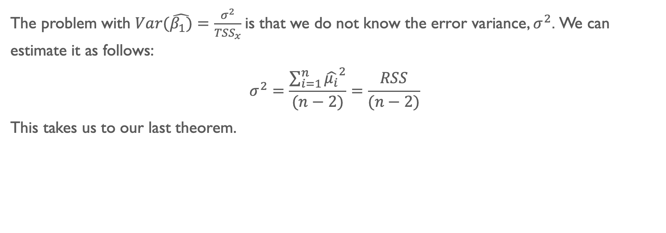
The problem with $Var(\hat{β_{1})}=\frac{σ^{2}}{{TSS}_{x}}$is that we do not know the error variance, $σ^{2}$. We can estimate it as follows:
$$σ^{2}=\frac{\sum_{i=1}^{n}{{\hat{μ_{i}}}^{2}}}{(n−2)}=\frac{RSS}{(n−2)}$$
This takes us to our last theorem.

Slide 34
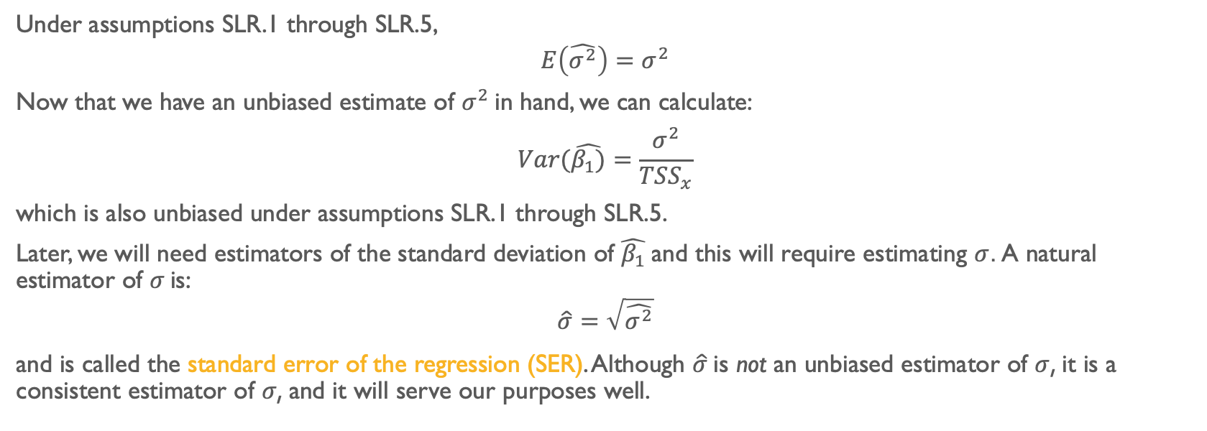
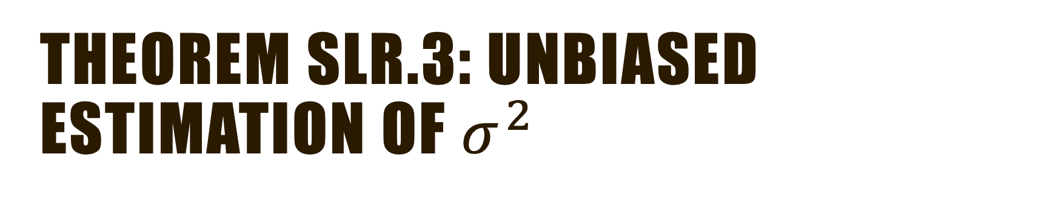
Theorem SLR.3: Unbiased estimation of $σ^{2}$
Under assumptions SLR.1 through SLR.5,
$$E\left(\hat{σ^{2}}\right)=σ^{2}$$
Now that we have an unbiased estimate of $σ^{2}$ in hand, we can calculate:
$$Var(\hat{β_{1})}=\frac{σ^{2}}{{TSS}_{x}}$$
which is also unbiased under assumptions SLR.1 through SLR.5.
Later, we will need estimators of the standard deviation of $\hat{β_{1}}$and this will require estimating $σ$. A natural estimator of $σ$ is:
$$\hat{σ}=\sqrt{\hat{σ^{2}}}$$
and is called the standard error of the regression (SER). Although $\hat{σ}$is not an unbiased estimator of $σ$, it is a consistent estimator of $σ$, and it will serve our purposes well.

Slide 35
Interpretation of Confidence Intervals
…and the OLS estimates…

Slide 36
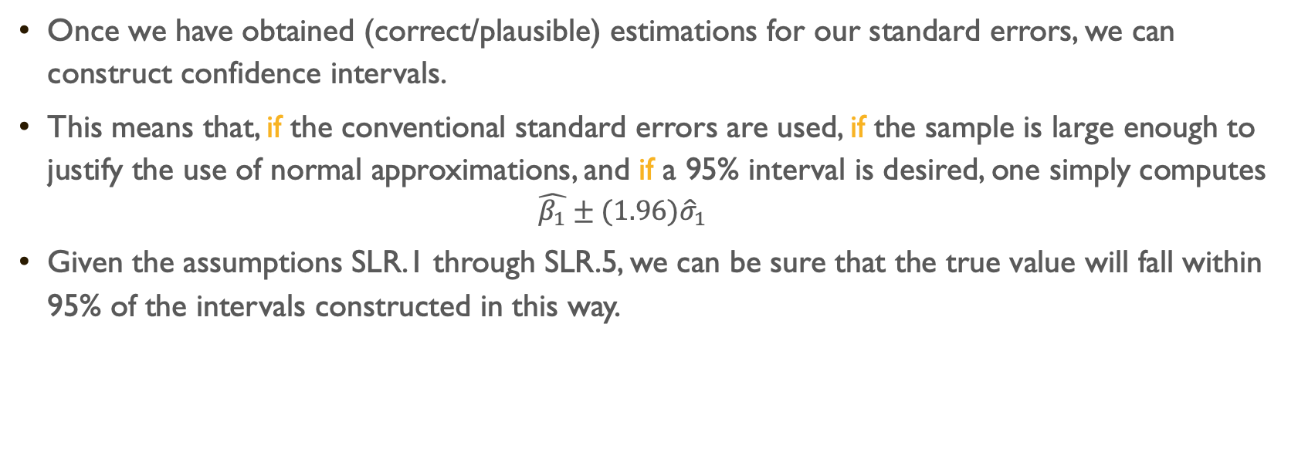
Once we have obtained (correct/plausible) estimations for our standard errors, we can construct confidence intervals.
This means that, if the conventional standard errors are used, if the sample is large enough to justify the use of normal approximations, and if a 95% interval is desired, one simply computes
$$\hat{β_{1}}±(1.96){\hat{σ}}_{1}$$
Given the assumptions SLR.1 through SLR.5, we can be sure that the true value will fall within 95% of the intervals constructed in this way.

Slide 37
Most social scientists use regression confidence intervals to carry out significance tests of whether particular variables make a difference.
That is, they provisionally assume that the true regression coefficient (or set of coefficients) is zero and then assess how likely it is that the estimated coefficients could have occurred by chance (i.e., reject the null).
It is traditional to reject the null hypothesis (i.e., decide that the coefficient does make a difference) if this probability is less than 5%. Otherwise, the null hypothesis that there is no effect is maintained.

Slide 38
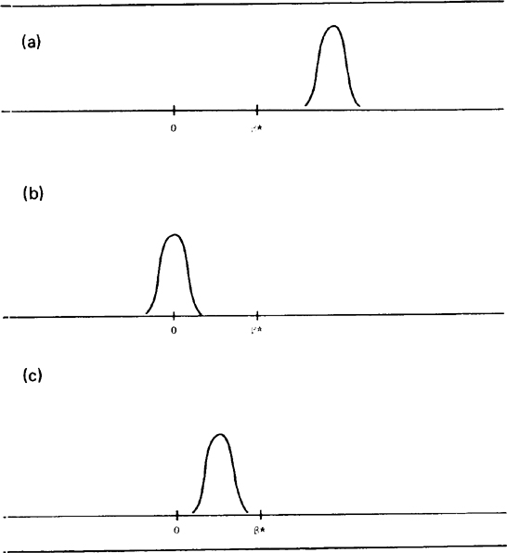


Statistical Significance
$$\hat{β_{1}}$$
$$\hat{β_{1}}=$$
Statistically significant
Not statistically significant

Slide 39
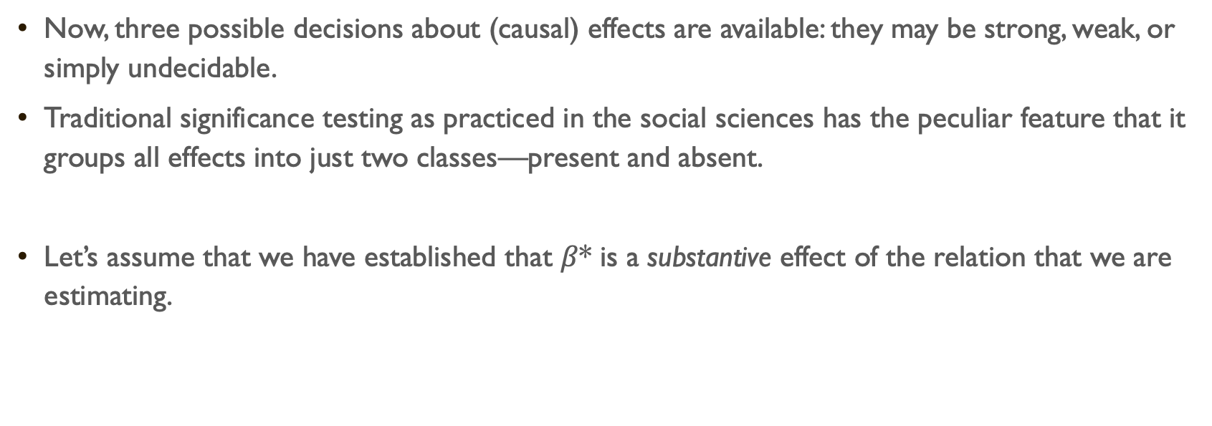
Substantive significance
Now, three possible decisions about (causal) effects are available: they may be strong, weak, or simply undecidable.
Traditional significance testing as practiced in the social sciences has the peculiar feature that it groups all effects into just two classes—present and absent.
Let’s assume that we have established that $β$* is a substantive effect of the relation that we are estimating.

Slide 40


$β$*
Both statistically and substantively significant
Neither statistically nor substantively significant
Statistically significant but not substantively significant
$β$*
$β$*

Slide 41
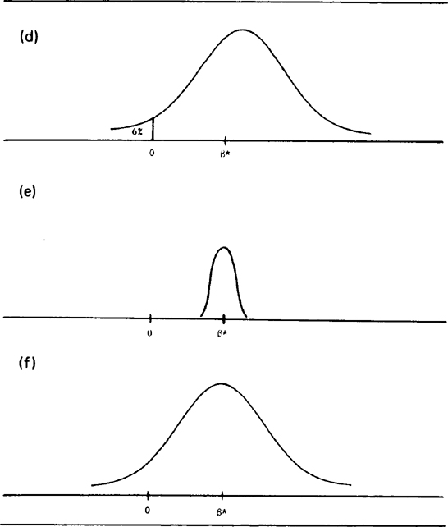


$β$*
No statistical significance; likely substantive significance
Statistical significance; substantive uncertainty
No statistical significance; substantive uncertainty
$β$*
$β$*

Slide 42
So, how do we establish substantive significance?
Theory!
Look at the distribution of your variables!
Comparable results!
What else?

